Slide 1
Digital Portfolio
STUDENT NAME: Sangeetha.E
REGISTER NO AND NMID: 30124B0BE4D2C6D9F284D9BED735E2DC
DEPARTMENT: Computer science department
COLLEGE: Vidhya Sagar Women’s college/ University of Madras

Slide 2

PROJECT TITLE
PROJECT TITLE
Student Digital Portfolio
WEB DEVELOPER

Slide 3


AGENDA
Problem Statement
Project Overview
End Users
Tools and Technologies
Portfolio design and Layout
Features and Functionality
Results and Screenshots
Conclusion
Github Link
3/21/2024 Annual Review

Slide 4

PROBLEM STATEMENT
An interactive way to showcase my work, skills, and personality.
It shows the way how i present it. Through the animations, designs and )responsiveness.
Recruiters and clients can see my creativity and coding style.· Easy to share.
A static resume can't serve the above mentioned features.
So, a digital portfolio is more suitable for the current competitive world.

Slide 5

PROJECT OVERVIEW
An interactive way to showcase my work, skills, and personality.
It shows the way how i present it. Through the animations, designs and )responsiveness.
Recruiters and clients can see my creativity and coding style.· Easy to share.
A static resume can't serve the above mentioned features.
So, a digital portfolio is more suitable for the current competitive world.

Slide 6

WHO ARE THE END USERS?
WHO ARE THE END USERS?
Me : I can use it as my identity. Since it can be easily accessed, i can update my porfolio.
2.Recruiters and Hiring Manager8: This portfolio can showcase my talent and skills, based on this portfolio they can hire me easily.
3.Clients Freelance): IfI'm working as a freelancer, I can show my own portfolio as an example to the client. Clients can judge me based on my work, they can get some idea about my work.Clients can contact me easily through the contact section in my portfolio.

Slide 7

TOOLS AND TECHNIQUES
1.HTML
Provides the structure of the portfolio.
Used for headings, sections, images, lists, and links.
Example:<header>, <section>, <img>, <form>.
2.CSS
Handles design, layout, colors, and animations.
Used flexbox and grid for responsiveness.
Magenta shades applied for consistent theme.
Example: transition, animation.
3.JavaScript
Adds interactivity and animations. Used for scroll animations, form interactivity, and dynamic effects.
Example: elements fading in when scrolling down.

Slide 8
TOOLS AND TECHNIQUES
4.Responsive Design
ToolsMedia queries to adjust design for mobile, tablet, desktop.
Flexible layouts using flexbox/grid.· Ensures portfolio looks good on all screens.
5.Web Fonts and Emoijs·
Fonts (like Google Fonts) used to make text stylish.
Emoijs add personality and make sections lively.
6.Icons/Images
Profile photo (placeholder or real).. Icons/emojis in skills, contact, achievements.
Example: for achievements, for mobile, for location.

Slide 9
TOOLS AND TECHNIQUES
1.Transitions & Hover Effects
Buttons and cards change color/size smoothly when hovered.
Example: Project cards zoom slightly when mouse is overthem.
2.Scroll Animations
Sections fade/slide in as the user scrolls down.
Gives a modern, engaging look.
3.Animations (CSS keyframes)
Movinggradient background.
Text fade-in effects.
Creates a sense of liveliness.
4.Form Handling
Contact form with fields (name, email, message).
Uses basic JavaScript + mailto:for sending email.
5.Color Theming(Magenta Palette)
Different shades of magenta applied consistently.
Enhances branding and uniqueness.
The entire code was written and executed in Code Pen.

Slide 10
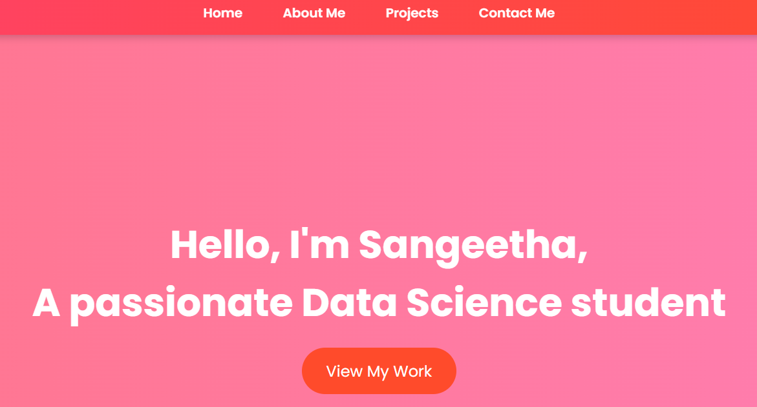
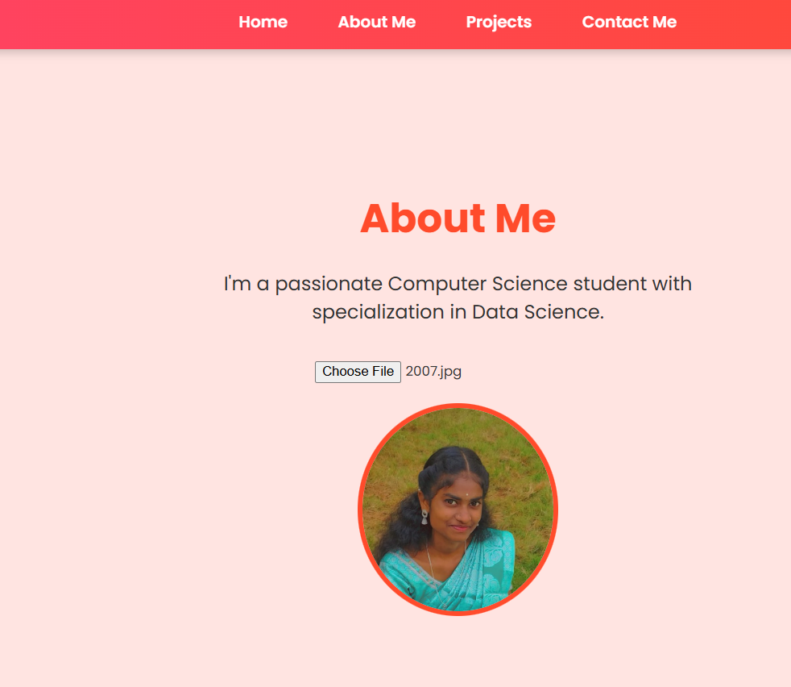
POTFOLIO DESIGN AND LAYOUT
1.Home
My name, title and a short tagline.
Eye-catching background with magenta gradient + animations.
Purpose: Immediately tells the visitor who I am.
2.Personal Details /About Me
Age, mobile number O, email X, location
A short introduction about myself, passion, and career goals.
Purpose: Builds personal connection; recruiters/clients know whoI'm and how to reach me.
10

Slide 11
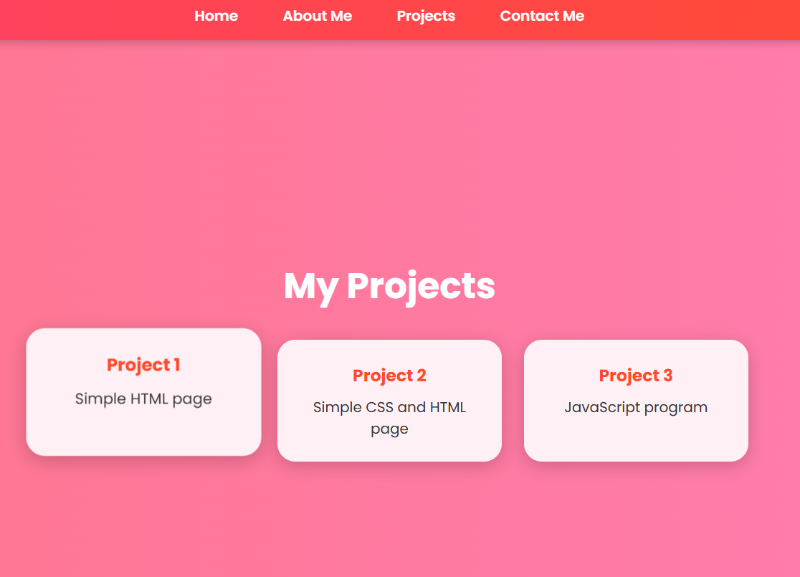
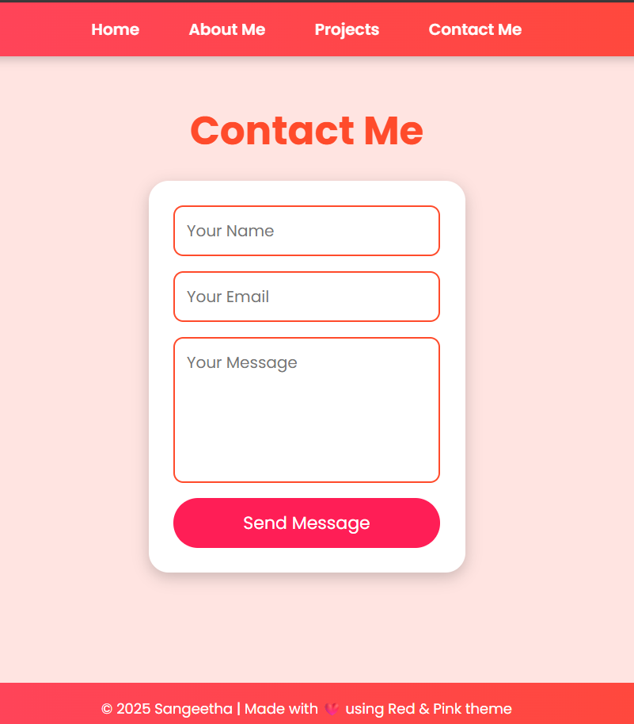
POTFOLIO DESIGN AND LAYOUT
3.Projects.
Sections with project titles and descriptions.
Example:“Registration Form",“Portfolio Website”.
4.Contact Section:
A simple form(name,email,message.
Direct links.

Slide 12
FEATURES AND FUNCTIONALITY
: Clearly divided parts → Home, Personal Details, Studies, Projects, Achievements, Sk1.Structured Elements
Featureills, Contact.
How it works: HTML semantic tags (ssection>, <header>, <footer>).
Benefit: Easy navigation, organized information, improves readability.
2.Responsive Design
Feature: Works on mobile, tablet, and desktop.
How it works: CSS Grid + media queries.
Benefit: Recruiters or clients can open my portfolio on any device without broken layout.
3.Magenta Colour Theme
Feature: Unique magenta + shades applied consistently across sections
How it works: CSS color variables and gradients.
Benefit: Strong branding, aesthetic appeal, and uniqueness compared to plain resumes.

Slide 13
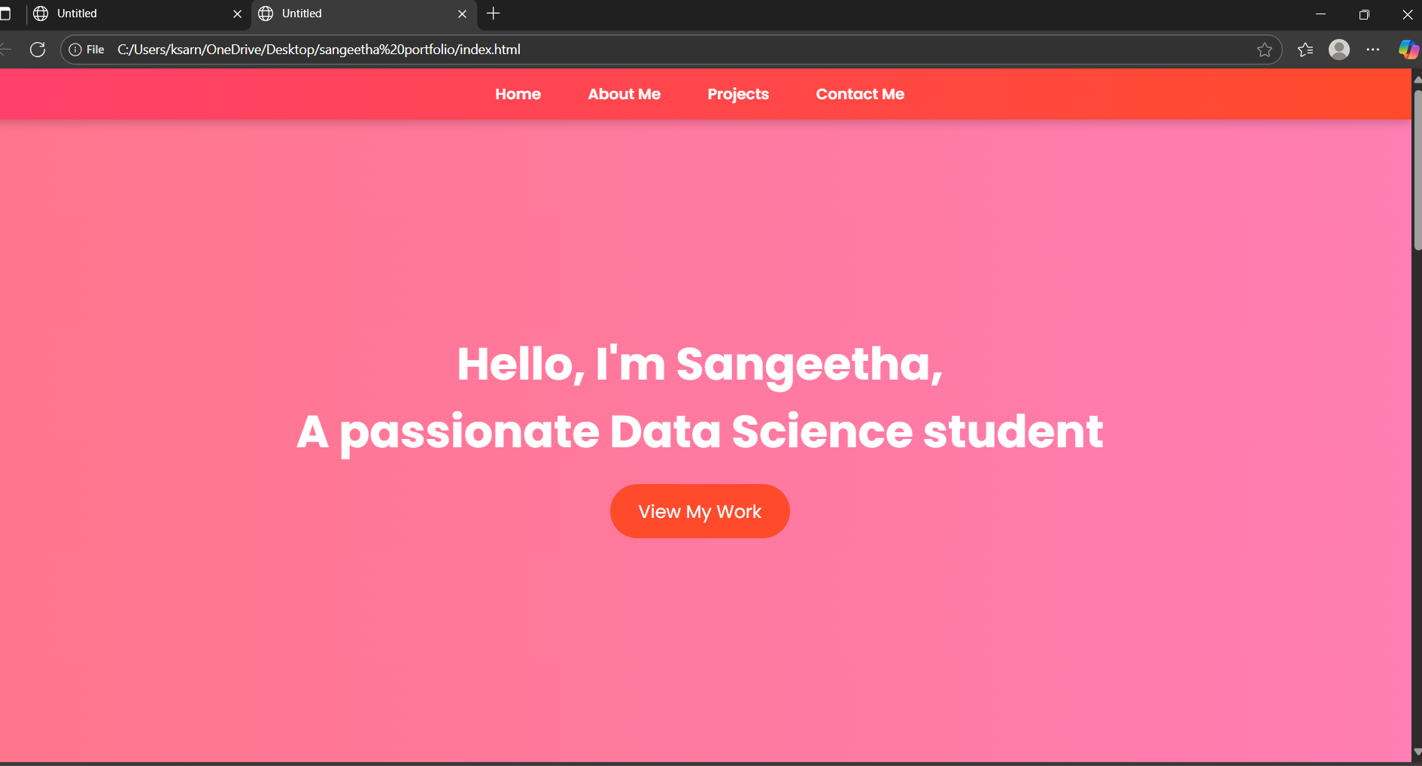
RESULTS AND SCREENSHOTS

Slide 14
RESULTS AND SCREENSHOTS

Slide 15

RESULTS AND SCREENSHOTS
3/21/2024 Annual Review
15

Slide 16
RESULTS AND SCREENSHOTS

Slide 17
CONCLUSION
This digital portfolio is more than just a collection of details — it is a personal brand showcase.
Unlike a traditional resume, which only provides static information, the portfolio presents my skills, achievements, and projects in an interactive, visually engaging, and professional manner.
By integrating animations, transitions, and a responsive design, it ensures that the content is both attractive and accessible on anydevice.
The magenta theme gives it a unique identity, while structured like Home, About, Education, Projects, Achievements, Skills, and Contact guide the visitor through a clear and impactful journey.
17

Slide 18
THANK YOU

